Slide 1
Presumptive Eligibility Tool ILT
Adult

Slide 2
Presumptive Eligibility Tool ILT: Adult
Introduction
In this course you will learn about the:
Goals of Presumptive Eligibility
Basics of the PE Tool
PE for Adults
Medical Consumer Self-Service Portal
Various Administrative Features in the Tool

Slide 3
Presumptive Eligibility Tool ILT: Adult
Agenda
Lesson 1: Overview
Lesson 2: PE Tool Basics
Lesson 3: PE Adult
Lesson 4: MCSSP
Lesson 5: Administrative Features

Slide 4
Presumptive Eligibility Tool ILT: Adult
Lesson 1: Overview > PE Defined
Presumptive Eligibility (PE) is a program that provides temporary medical coverage for eligible persons at the time a medical service is provided. Only designated clinics and hospitals, referred to as Qualified Entities (QE), are able to determine eligibility for PE.
A goal of the PE program is to provide temporary medical coverage while the person successfully completes the KanCare application process.
Related to this is the PE program’s ultimate goal: to enroll eligible persons in ongoing KanCare coverage.

Slide 5
Presumptive Eligibility Tool ILT: Adult
Lesson 1: Overview > PE Defined
In addition to completing the PE determination, QE staff work with consumers to complete the KanCare application and obtain the verifications needed to determine eligibility.
The work of Qualified Entity staff is essential in meeting the goals of the PE program.

Slide 6
Presumptive Eligibility Tool ILT: Adult
Lesson 1: Overview > PE History
Prior to the KEES project, PE determinations were completed by using a paper Tool which was then faxed into the KanCare Clearinghouse.
This changed with the creation of a web-based Tool that was implemented during Phase 1 of KEES (approximately June 2012). The Phase 1 PE Tool completed determinations for the Presumptive Eligibility for Children (PE CH) program. Populated notices and release forms were also part of the Phase 1 PE Tool. Throughout Phase 1, QE staff continued to fax notices and releases to the KanCare Clearinghouse.

Slide 7
Presumptive Eligibility Tool ILT: Adult
Lesson 1: Overview > P2 Functionality
The Phase 2 PE Tool builds and expands upon this functionality. The main features of the new P2 PE Tool are:
A separate PE Tool for Pregnant Woman (PE PW).
A separate PE Tool for Adults (PE Adult).
Data as well as the results from the PE Tool will be automatically sent to the new eligibility system, KEES.

Slide 8
Presumptive Eligibility Tool ILT: Adult
Lesson 1: Overview > Summary
That completes Lesson 1. This Overview lesson discussed the:
Definition of PE
Goals of PE
Phase 1 PE Tool
Phase 2 PE Tool
We will review PE Tool Basics next.

Slide 9
Presumptive Eligibility Tool ILT: Adult
Agenda
Lesson 1: Overview
Lesson 2: PE Tool Basics
Lesson 3: PE Adult
Lesson 4: MCSSP
Lesson 5: Administrative Features

Slide 10
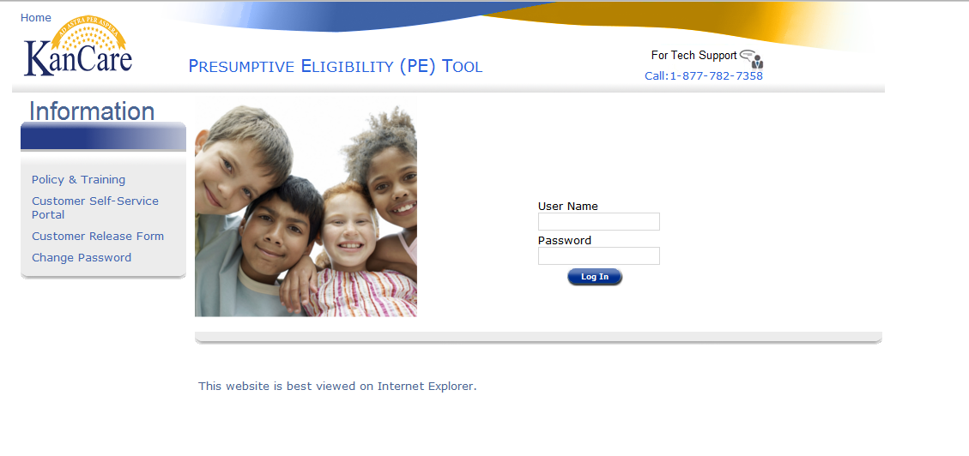
Presumptive Eligibility Tool ILT: Adult
Lesson 2: PE Tool Basics > Login
As mentioned in the previous lesson, the Presumptive Eligibility (PE) Tool is a web-based application. It is accessed via a URL or link on the Internet. Upon clicking the link, the Login to the PE Tool is displayed.

Slide 11
Presumptive Eligibility Tool ILT: Adult
Lesson 2: PE Tool Basics > Login Page
On this page, the following can be found:
Username and Password Text boxes
Links to:
Policy and Training
Medical Consumer Self-Service Portal
Customer Release Form
Change Password
The number for Tech Support

Slide 12
Presumptive Eligibility Tool ILT: Adult
Lesson 2: PE Tool Basics > Login Page > Policy and Training Links
Policy and Training is the first link on the Login page. Clicking this link navigates the user to various Policy references and mandates that pertain to Presumptive Eligibility. Each reference is a hyperlink that directs the user to the related information.

Slide 13
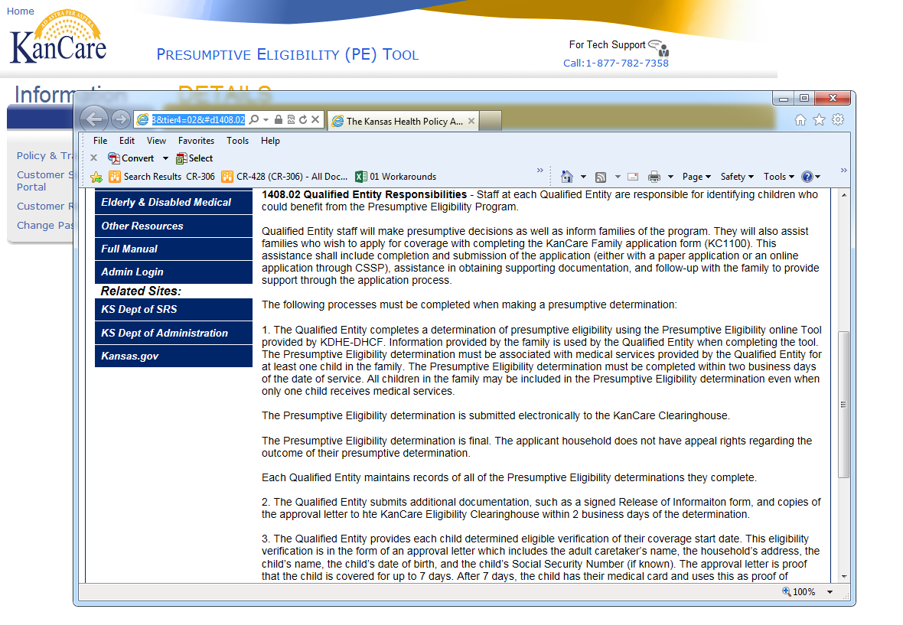
Presumptive Eligibility Tool ILT: Adult
Lesson 2: PE Tool Basics > Login Page > Policy and Training Links
The Policy and Training information will display in a separate pop-up window. Click the X at the top right-hand side of the pop up window to return to the PE Tool.

Slide 14
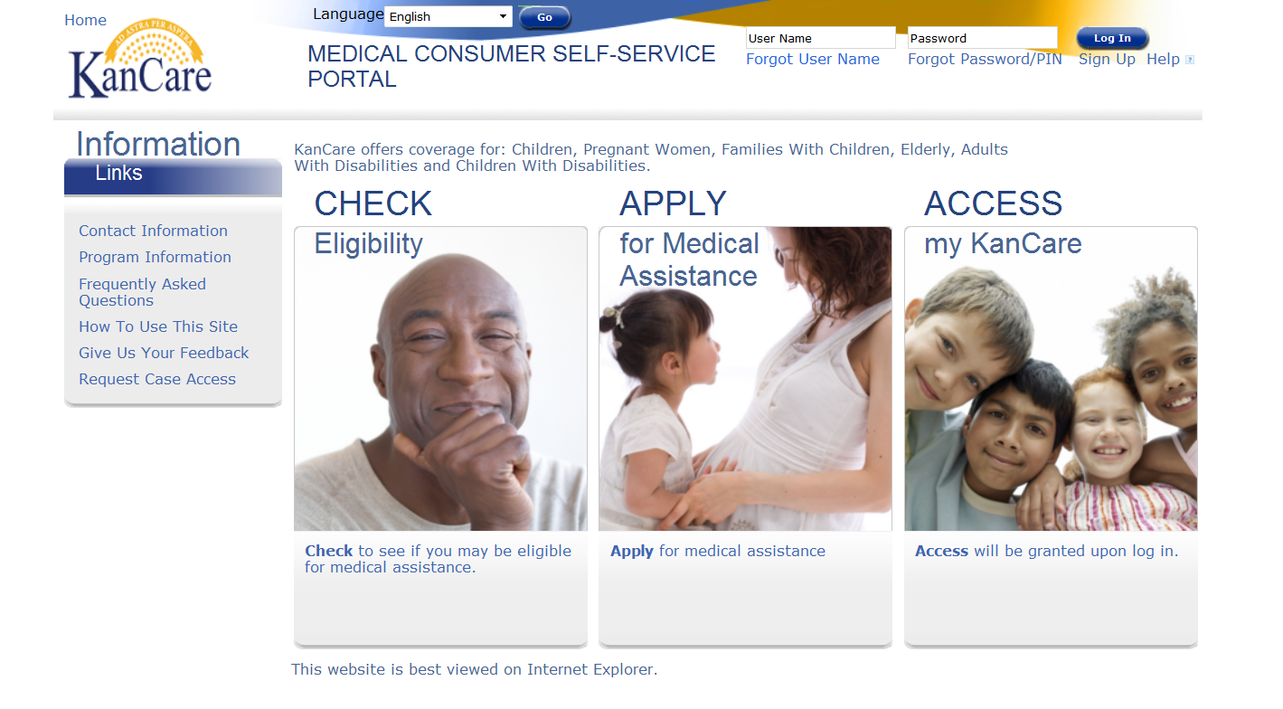
Presumptive Eligibility Tool ILT: Adult
Lesson 2: PE Tool Basics > Login Page > MCSSP Links
The next link is to the Medical Consumer Self-Service Portal (MCSSP). The MCSSP is a web-based application for KanCare benefits.

Slide 15
Presumptive Eligibility Tool ILT: Adult
Lesson 2: PE Tool Basics > Login Page > MCSSP Links
An overview of the different sections of the MCSSP is listed below. More information about completing the MCSSP application will be discussed in Lesson 5.
Check Eligibility
A self-assessment to check for potential eligibility.
Apply for Medical Assistance
Web-based application for all medical programs.
Access my KanCare
Access to submitted MCSSP applications.

Slide 16
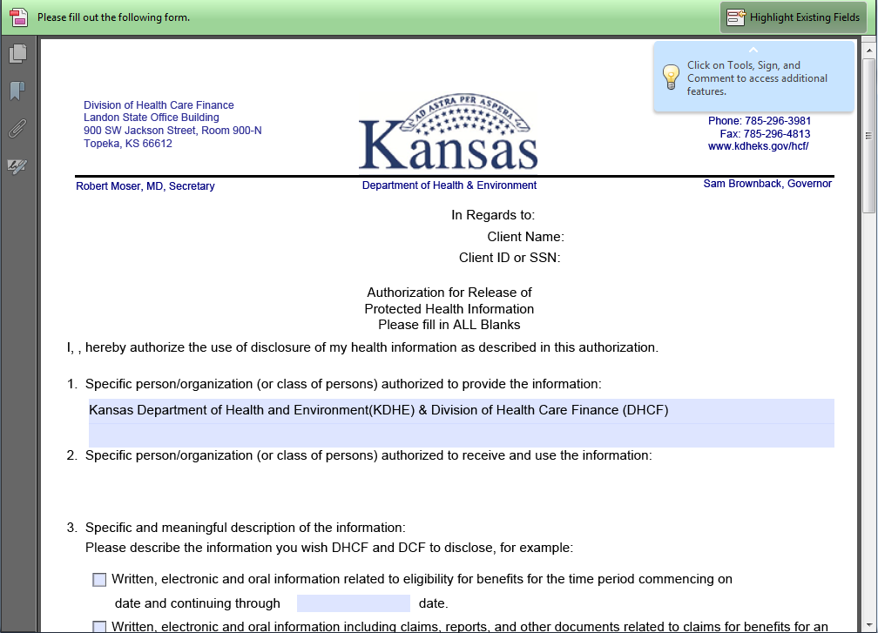
Presumptive Eligibility Tool ILT: Adult
Lesson 2: PE Tool Basics > Login Page > Customer Release Form
A blank Customer Release form can also be accessed on the login page. QE staff can use this if a Release form is needed outside the context of the PE Tool.

Slide 17
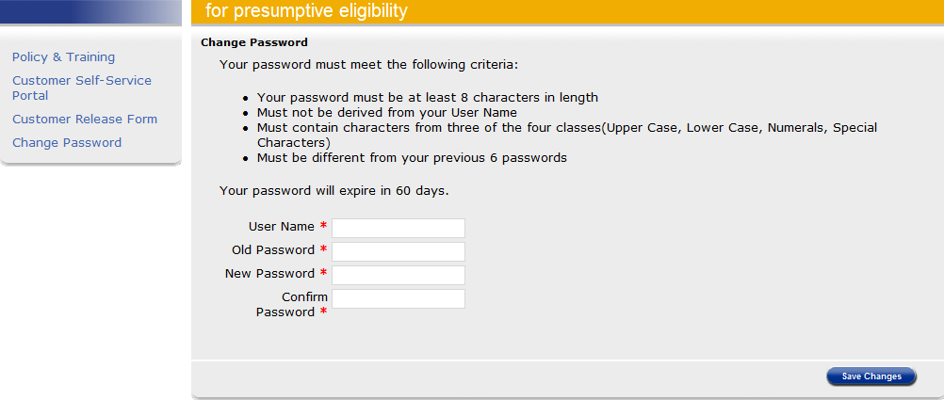
Presumptive Eligibility Tool ILT: Adult
Lesson 2: PE Tool Basics > Login Page > Change Password Link
The last link is used to change a password to the PE Tool. When you initially log into the PE Tool it’s recommended that you change your password.
To change a password, the User Name, Old Password, and New Password must be entered. The New Password must be entered again in the Confirm Password field.

Slide 18
Presumptive Eligibility Tool ILT: Adult
Lesson 2: PE Tool Basics > Login Page > Password Criteria
The following criteria pertains to the PE Tool password:
It needs to be changed every 60 days.
If the password isn’t changed within 60 days, it will expire and lock the QE staff out of the PE Tool.
A message will display 15 days before the password expires.
Contact Tech Support if your password has expired so it can be reset.

Slide 19
Presumptive Eligibility Tool ILT: Adult
Lesson 2: PE Tool Basics > Login Page > Password Criteria
Passwords to the PE Tool must:
Be at least 8 characters long
Contain 3 out of 4 of the following:
Upper Case
Lower Case
Numerals
Special Characters
Differ from the previous 6 passwords
Differ from your User Name

Slide 20
Presumptive Eligibility Tool ILT: Adult
Lesson 2: PE Tool Basics > Login Page > Tech Support
The Tech Support phone number is the final field on the Login page to review. QE Staff need to call this number when they have technical issues, password problems, or questions regarding the PE Tool.

Slide 21
Presumptive Eligibility Tool ILT: Adult
Lesson 2: PE Tool Basics > Overview Page
After logging into the PE Tool, the PE Overview page is displayed. This page provides:
Definitions of the PE programs
General Rules of the PE Tool
Instructions on how to complete each of the PE Tools
We’ll review the General Rules of the PE Tools next.

Slide 22
Presumptive Eligibility Tool ILT: Adult
Lesson 2: PE Tool Basics > PE Overview > General Rules
QE Staff may not have access to all of the PE Tools.
The PE Adult Tool will only be provided to approved hospitals.
In most situations, all family members should be on the same PE case.
Navigate between the Tools to complete determinations for all family members.
When multiple family members apply for PE the Tools must be completed in a specific order.
The order to follow when using multiple Tools for a single household is
PE Adult > PE PW > PE CH
A Primary Applicant is needed for all PE Tools.
The Primary Applicant must be the same for all PE Tools completed for a household.

Slide 23
Presumptive Eligibility Tool ILT: Adult
Lesson 2: PE Tool Basics > PE Overview > General Rules
Same PE Tool
Spouses living together
Unmarried Couples with mutual children who live together
Separate PE Tools
Unmarried couples with no mutual children
Adult children (over 18) even when living with their parents
Single adults

Slide 24
Presumptive Eligibility Tool ILT: Adult
Lesson 2: PE Tool Basics > Primary Applicant Defined
Primary Applicant Information is the first page for all of the PE Tools. This page is used to gather information regarding the person, parent, or caretaker who is the head of the household. The Primary Applicant may be applying for themselves and/or on behalf of others in their household. As stated earlier, the Primary Applicant is the same when multiple PE Tools are needed for a single household.
Primary Applicants are:
Adults
Legally Emancipated Minors

Slide 25
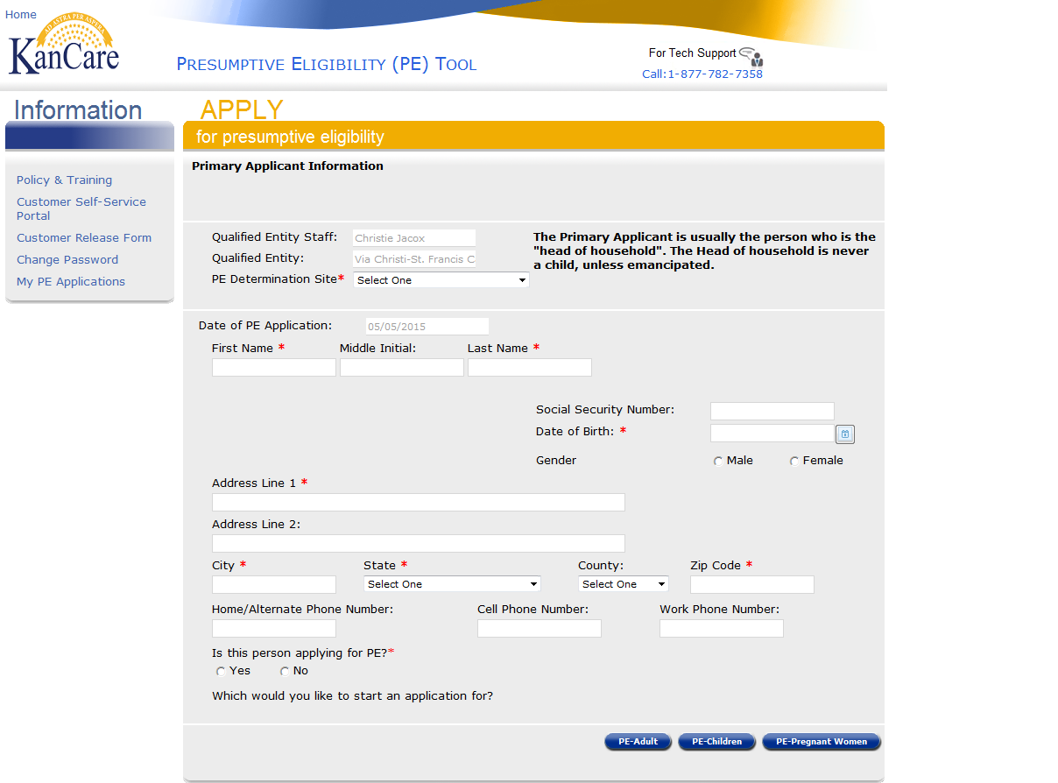
Presumptive Eligibility Tool ILT: Adult
Lesson 2: PE Tool Basics > Primary Applicant Information
The QE Staff and QE auto-populate based on the user’s login information.
The following information is needed for the Primary Applicant Information page:
First and Last Name
Date of Birth
Gender
Address
Applying for Self
Providing a Social Security Number is optional.
Select the appropriate PE Determination Site.
The Date of PE Application only populates after the Results have been accepted.

Slide 26
Presumptive Eligibility Tool ILT: Adult
Lesson 2: PE Tool Basics > Primary Applicant Information
Once the Primary Applicant Information page has been completed, you will need to choose which PE Tool to complete. Our next lesson will focus on the PE Adult Tool.

Slide 27
Presumptive Eligibility Tool ILT: Adult
Lesson 2: PE Tool Basics > Summary
That completes Lesson 2. In this lesson, we reviewed the following pages in the PE Tool:
Login
Overview
General Rules
Primary Applicant Information
The PE Adult Tool will be discussed in the next lesson.

Slide 28
Presumptive Eligibility Tool ILT: Adult
Agenda
Lesson 1: Overview
Lesson 2: PE Tool Basics
Lesson 3: PE Adult
Lesson 4: MCCSP
Lesson 5: Administrative Features

Slide 29
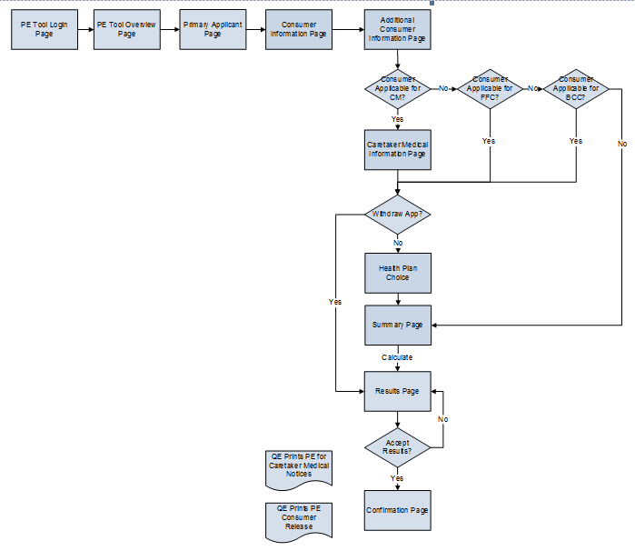
Presumptive Eligibility Tool ILT: Adult
Lesson 3: Adult > PE Adult Tool Screen Flow
Clicking the PE – Adult button on the Primary Applicant Information page initiates the PE Adult Tool. Below is the screen flow of the PE Adult Tool.

Slide 30
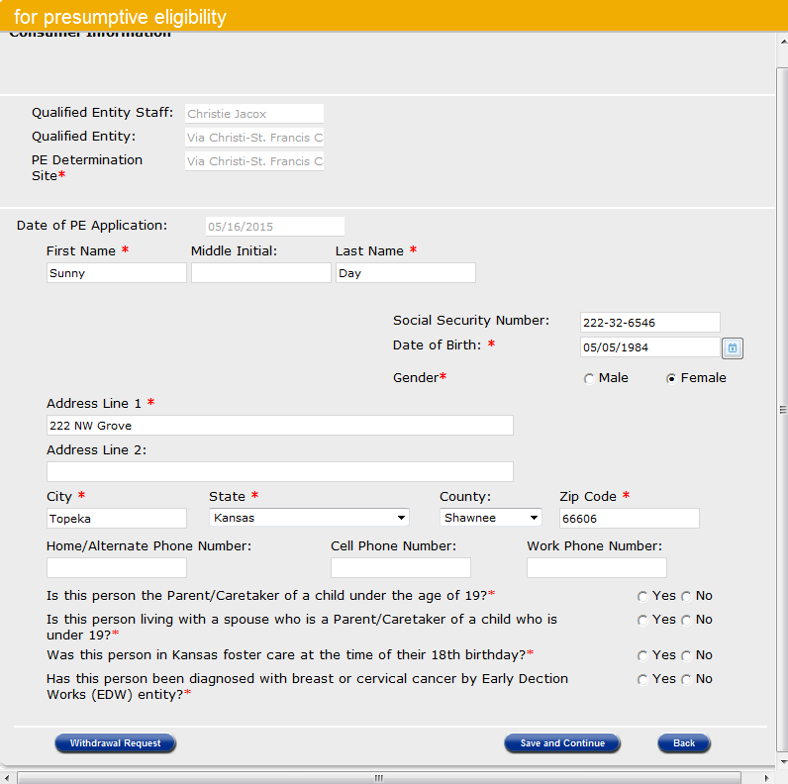
Presumptive Eligibility Tool ILT: Adult
Lesson 3: PE Adult > Consumer Information
After clicking the PE – Adult button on the Primary Applicant Information page, the Consumer Information page displays.
The following information auto-populates when the Primary Applicant indicates that they are applying for coverage:
Name
SSN (optional)
Gender
Address
Phone Number
The SSN may not be present as this is optional.
The PE Determination Site auto-populates from the Primary Applicant page.
The Date of PE Application only populates after the Results have been accepted.
The consumer must answer the questions listed below:
Parent/Caretaker of child under 19
Living with a Parent/Caretaker Spouse of child under 19
In Kansas Foster Care on 18th birthday
Diagnosed by Early Detection Works (EDW)

Slide 31
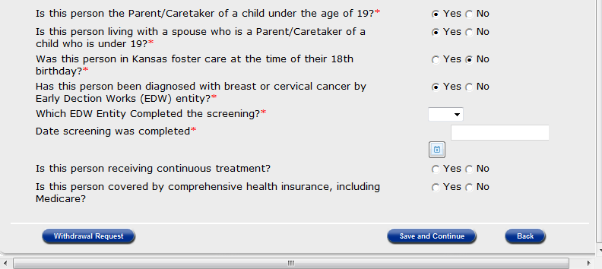
Presumptive Eligibility Tool ILT: Adult
Lesson 3: PE Adult > Consumer Information > BCC
When a consumer indicates that they have been diagnosed for breast or cervical cancer by EDW, additional questions display requesting the:
EDW entity that completed the screening
Date screening occurred
Status of continuous treatment
Presence of comprehensive health insurance

Slide 32
Presumptive Eligibility Tool ILT: Adult
Lesson 3: PE Adult > Consumer Information > Withdrawal
At any point in the application process, a consumer can withdraw their request for coverage by using the Withdrawal button. Clicking the Withdrawal button takes the user to the Results page which indicates that the Tool will be denied due to the applicant’s voluntary withdrawal from the PE process. Clicking the Accept Results button confirms the denial for voluntary withdrawal. Using the Back button returns staff to the Consumer Information page.

Slide 33
Presumptive Eligibility Tool ILT: Adult
Lesson 3: PE Adult > Additional Consumer Information
The next page displayed is Additional Consumer Information. Questions about the consumer’s citizenship and marital status are located on this page.

Slide 34
Presumptive Eligibility Tool ILT: Adult
Lesson 3: PE Adult > Additional Consumer Info > Non-Citizen
If the consumer is not a U.S. Citizen and answers Yes for the Is this person a Documented Non-Citizen question, a dropdown will display to select the type of documented non-citizen.

Slide 35
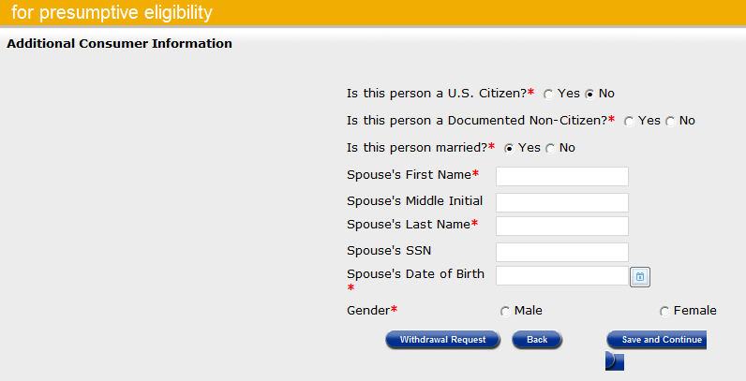
Presumptive Eligibility Tool ILT: Adult
Lesson 3: PE Adult > Additional Consumer Information > Spouse
If the consumer indicates they are married text box fields display requesting:
Spouse’s First and Last Name
Spouse’s Date of Birth
Gender
There is a field requesting the Spouse’s Social Security Number but this is not mandatory.

Slide 36
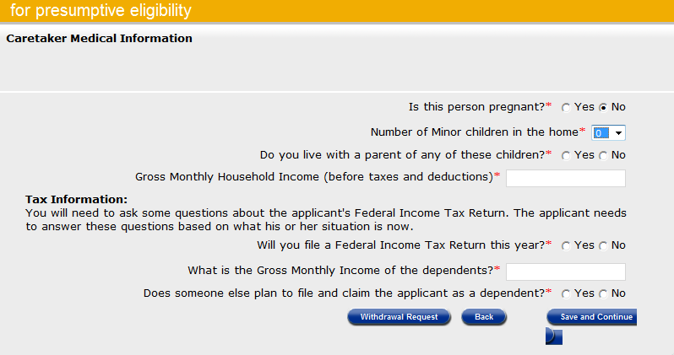
Presumptive Eligibility Tool ILT: Adult
Lesson 3: PE Adult > Caretaker Medical Information
When a consumer or spouse is the parent or caretaker of a child under the age of 19, the Caretaker Medical page displays.
The following questions are found on this page:
Pregnancy
Number of Children in the Home
Parents of Children
Gross Monthly Income
Tax Information

Slide 37
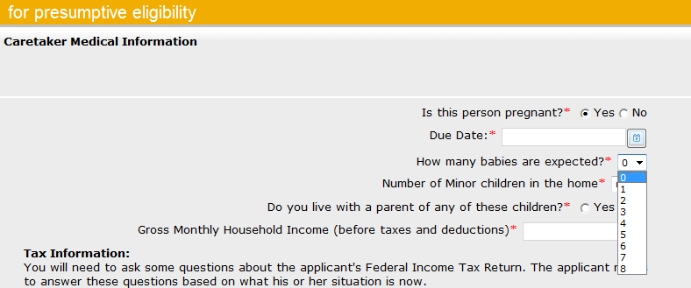
Presumptive Eligibility Tool ILT: Adult
Lesson 3: PE Adult > Caretaker Medical Information > Pregnancy
There are several dynamic questions on this page. If Yes is selected for the Is this person pregnant question, the following display:
Text box for the Due Date
Dropdown to select the number of babies she’s carrying

Slide 38
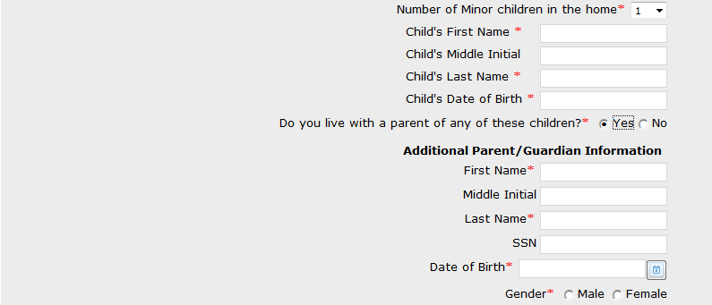
Presumptive Eligibility Tool ILT: Adult
Lesson 3: PE Adult > Caretaker Medical Info > Children & Parents
Additional fields display when the following are living in the home:
Children
Parent or Guardian
The following information is needed for each child living in the home:
First and Last Name
Date of Birth
The following information is needed for the parent/guardian when they live in the home. each child living in the home:
First and Last Name
Date of Birth
Gender
Providing a Social Security Number is optional.

Slide 39
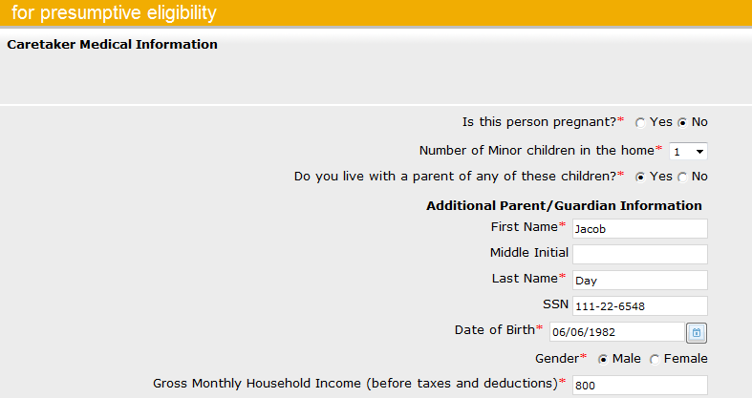
Presumptive Eligibility Tool ILT: Adult
Lesson 3: PE Adult > Caretaker Medical Info > Parent/Guardian Info
In this situation, the Spouse’s information is reentered since he is also the father of the child that resides in the home.

Slide 40
Presumptive Eligibility Tool ILT: Adult
Lesson 3: PE Adult > Caretaker Medical Info > Tax Information
The Tax Information section of this page has several dynamic questions as well. The core questions of this section concern whether the caretaker:
Will file a Federal Tax Return
Will claim dependents that aren’t included on the Tool
Be claimed by someone else as a dependent
The Gross Monthly Income of the other claimed dependents is also requested.
In most situations, the number of dependents the consumer will claim on their tax return will match the number of children in the home. If a consumer is claiming additional dependents that aren’t part of the Tool, this needs to be captured as it may impact their eligibility.

Slide 41
Presumptive Eligibility Tool ILT: Adult
Lesson 3: PE Adult > Caretaker Medical Info > Tax Information
Additional dynamic fields display when the Caretaker reports that they:
Won’t file a tax return
Will be claimed as a dependent by another tax filer
When this occurs, the following information is requested for the Tax Filer/Taxpayer:
Name
Relationship to Caretaker
Number of Dependents Claimed
Gross Monthly Income

Slide 42
Presumptive Eligibility Tool ILT: Adult
Lesson 3: PE Adult > Caretaker Medical Info > Tax Information
In this situation, the Spouse plans to file taxes and plans to claim the applicant as well as their child.

Slide 43
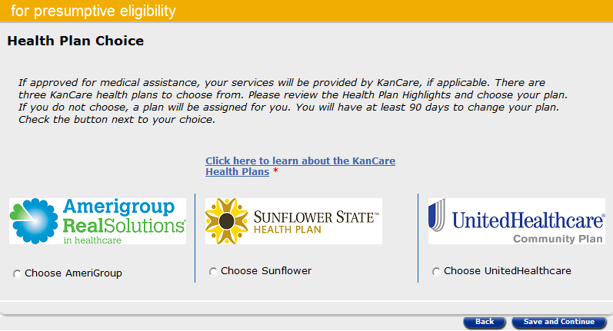
Presumptive Eligibility Tool ILT: Adult
Lesson 3: PE Adult > Health Plan Choice
Health Plan Choice is the next page. Use this page to indicate which KanCare health plan the parent or caretaker selects.

Slide 44
Presumptive Eligibility Tool ILT: Adult
Lesson 3: PE Adult > Summary
The Summary page is next. All of the data entered on the following pages is displayed:
Primary Applicant
Customer Information
Additional Customer Information
Caretaker Medical Information
QE staff need to thoroughly review this page to ensure that all of the data is correct. If an error is found, click the Edit button for the appropriate page to enter the correct information.
Once all the information is correct, click the Calculate button to determine if the parent or caretaker qualifies for PE.

Slide 45
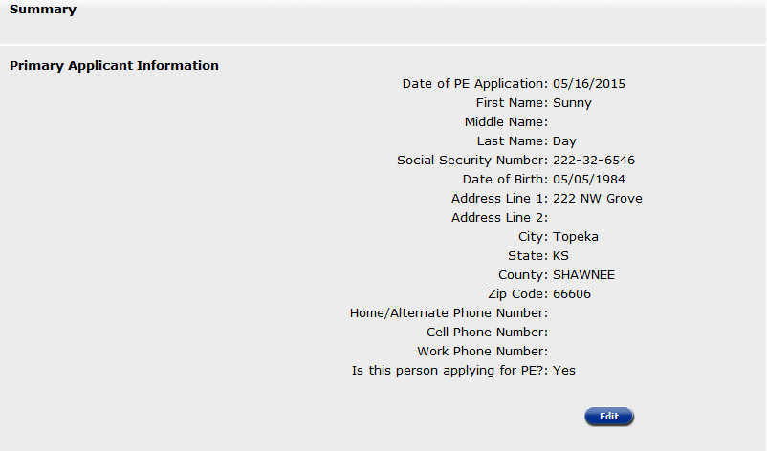
Presumptive Eligibility Tool ILT: Adult
Lesson 3: PE Adult > Summary > Primary Applicant Information
Primary Applicant Information is the first part of the Summary page. Use the Edit button to correct or add information to the Primary Applicant.

Slide 46
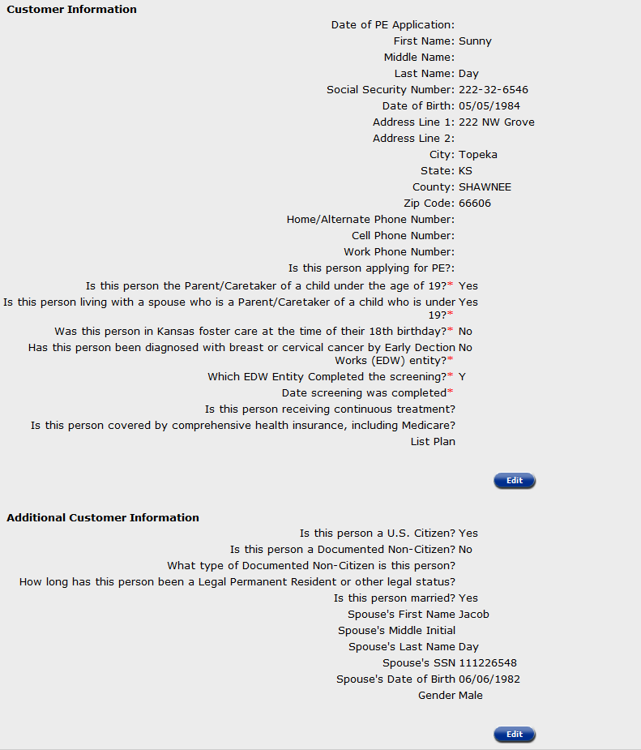
Presumptive Eligibility Tool ILT: Adult
Lesson 3: PE Adult > Summary > Customer Information
Customer Information and Additional Customer Information are the next sections displayed. Use the Edit button in either section to correct information as needed.

Slide 47
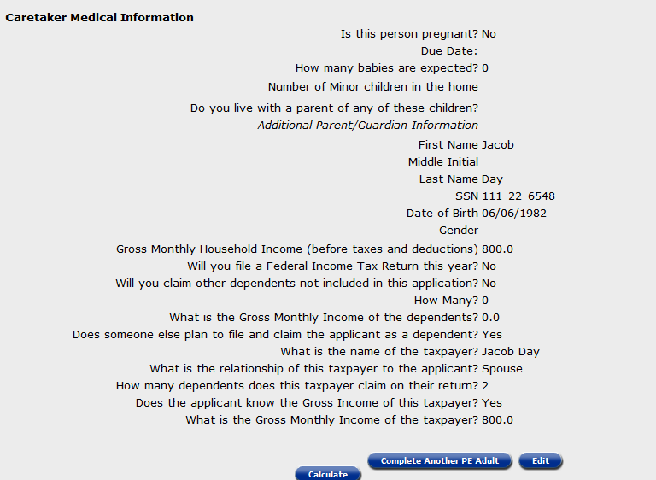
Presumptive Eligibility Tool ILT: Adult
Lesson 3: PE Adult > Summary > Caretaker Medical Information
The last section of the Summary Page is the Caretaker Medical Information. Once again, the Edit button can be used to change or update any of the Caretaker’s information. If everything on the Summary page is correct, click Calculate or the Complete Another PE Adult button if the other parent wants to apply for PE.

Slide 48
Presumptive Eligibility Tool ILT: Adult
Lesson 3: PE Adult > Results Page
The Results page is displayed. On this page the:
Results column indicates if the consumer was approved or denied for PE Adult coverage.
Reason/Type column indicates the consumer’s coverage type or the reason they were denied.

Slide 49
Presumptive Eligibility Tool ILT: Adult
Lesson 3: PE Adult > Results Page
At this point, you can choose to click one of the following buttons:
Accept Results as the PE Tool data and determination are correct
Back button to return to the Summary page
Review the data to ensure it’s correct
Edit the appropriate page if needed

Slide 50
Presumptive Eligibility Tool ILT: Adult
Lesson 3: PE Adult > Confirmation Page
The Confirmation Page displays after the results of the PE Tool have been accepted. An important field on this page is the confirmation number. This number will be displayed on all PE forms as well as the accompanying KanCare application when it’s filed through the MCSSP.

Slide 51
Presumptive Eligibility Tool ILT: Adult
Lesson 3: PE Adult > Confirmation Page
In addition to the pregnant woman’s name, result, and reason/type the Confirmation page allows staff to print the following:
English
Approval or Denial Notice
Release Form
Spanish
Approval or Denial Notice
Release Form

Slide 52
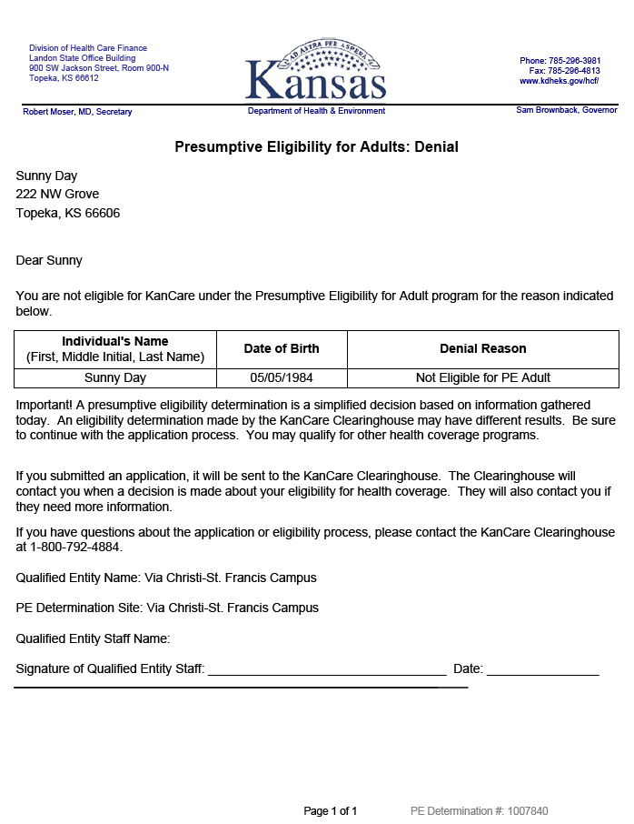
Presumptive Eligibility Tool ILT: Adult
Lesson 3: PE Adult > Confirmation Page > Notices
Remember that when a PE Tool is completed, a consumer should always be given a copy the approval or denial notice. A copy of the PE Tool notice must be faxed to the KanCare Clearinghouse.

Slide 53
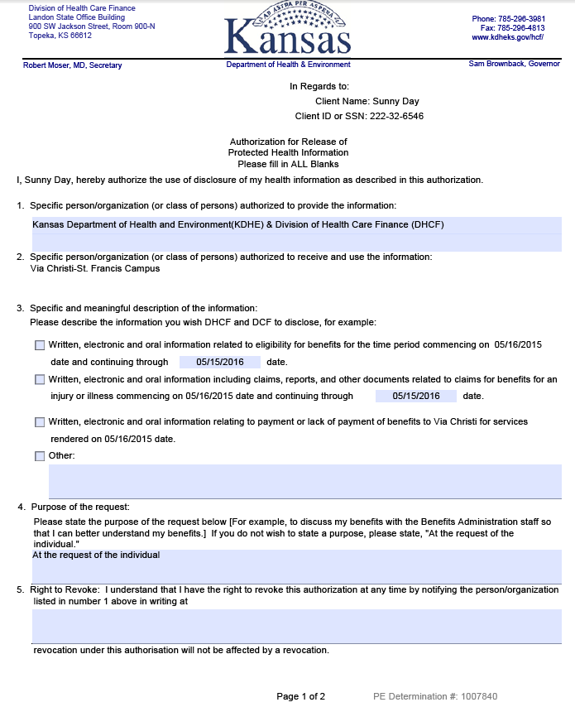
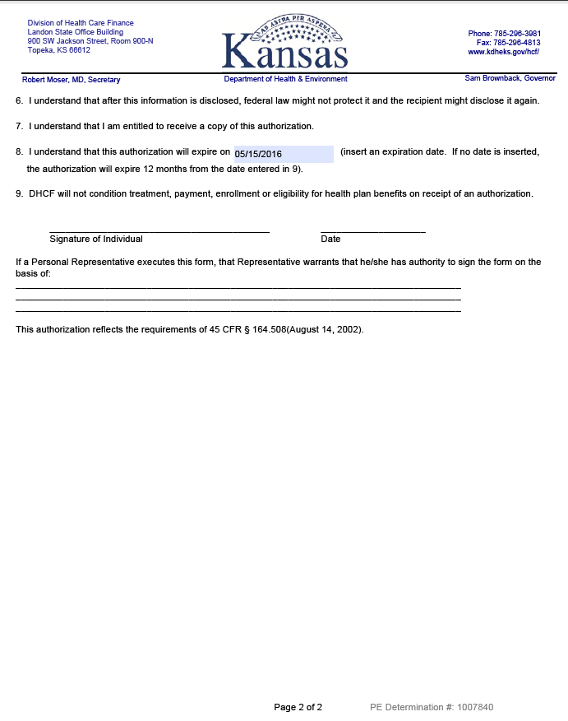
Presumptive Eligibility Tool ILT: Adult
Lesson 3: PE Adult > Confirmation Page > Release Form
Continue to use the Release Form in the PE Tool when a consumer wants QE Staff to communicate with the KanCare Clearinghouse about her application. This too must be faxed to the KanCare Clearinghouse.

Slide 54
Presumptive Eligibility Tool ILT: Adult
Lesson 3: PE Adult > Confirmation Page > Navigation
Once the PE Adult determination process is complete, staff may choose to complete a:
PE Tool for Pregnant Women
PE Tool for Children
KanCare Application for the Adult and/or Household
Remember that information from the PE Adult Tool will auto-populate to the PE PW Tool, PE CH Tool, and the Medical Consumer Self-Service Portal (MCSSP) KanCare application.

Slide 55
Presumptive Eligibility Tool ILT: Adult
Lesson 3: PE Adult > Confirmation Page > Navigation
You can also click the KanCare logo in the left-hand corner of the page. This will return the user to the Overview page.

Slide 56
Presumptive Eligibility Tool ILT: Adult
Lesson 3: PE Adult > Alternative Tool Navigation
Consumers who answer Yes to either of the questions listed below will have less pages of the PE Adult Tool to complete when children under the age of 19 aren’t in the home:
Was this person in Kansas foster care at the time of their 18th birthday?
Has this person been diagnosed with breast or cervical cancer by Early Detection Works (EDW) entity?

Slide 57
Presumptive Eligibility Tool ILT: Adult
Lesson 3: PE Adult > Alternative Tool Navigation
The workflow for these two groups is displayed in the following graphic.
Primary Applicant
Consumer Information
Additional Consumer Information
Health Plan Choice
Summary
Results
Confirmation

Slide 58
Presumptive Eligibility Tool ILT: Adult
Lesson 3: Summary
Lesson 3 is now complete. In this lesson, information regarding the PE Adult Tool was reviewed, including the:
Tool Page Flow
Tool Pages
Page Requirements
Navigation from the Tool
The Medical Consumer Self-Service Portal (MCSSP) will be discussed next.

Slide 59
Presumptive Eligibility Tool ILT: Adult
Agenda
Lesson 1: Overview
Lesson 2: PE Tool Basics
Lesson 3: PE Adult
Lesson 4: MCSSP
Lesson 5: Administrative Features

Slide 60
Presumptive Eligibility Tool ILT: Adult
Lesson 4: MCSSP
Once the PE Tool determination has been accepted and the Confirmation page displays, you will have the option to navigate to the Medical Consumer Self-Service Portal (MCSSP) to help the consumer complete the KanCare application.

Slide 61
Presumptive Eligibility Tool ILT: Adult
Lesson 4: PE Tool Basics > Login Page > MCSSP Links
An overview of the different sections of the MCSSP is listed below.
Check Eligibility
A self-assessment to check for potential eligibility.
Apply for Medical Assistance
Web-based application for all medical programs.
Access my KanCare
Access to submitted MCSSP applications.

Slide 62
Presumptive Eligibility Tool ILT: Adult
Lesson 4: MCSSP > Benefits
There are several benefits to applying through the MCSSP. When the MCSSP is used immediately following the PE Tool determination:
Information from the Tool, such as Names, Dates of Birth, and Social Security Numbers, auto-populates the MCSSP application.
The MCSSP’s Confirmation Number matches that of the PE Tool, thereby linking them together.

Slide 63
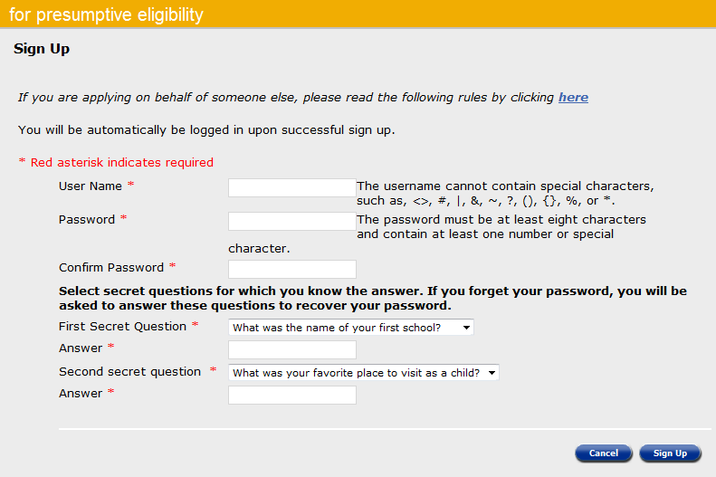
Presumptive Eligibility Tool ILT: Adult
Lesson 4: MCSSP > Sign Up Page
In order to complete an application through the MCSSP, the consumer must sign up. A consumer must have an email account, so it will be necessary to help them set one up in some situations.
The following information is needed to set up an account in the MCSSP:
User Name
Password
Confirm Password
1st Secret Question and Answer
2nd Secret Question and Answer

Slide 64
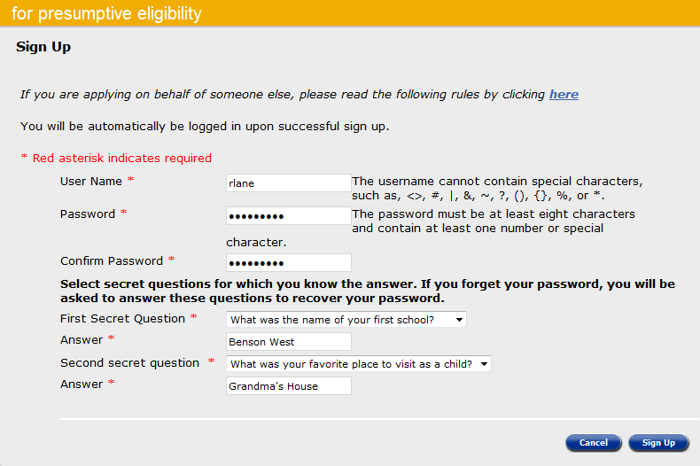
Presumptive Eligibility Tool ILT: Adult
Lesson 4: MCSSP > Sign Up Page
The MCSSP User Name can’t contain any special characters (# & * < % >).
The Password must be:
8 characters
Contain 1 special number or special character

Slide 65
Presumptive Eligibility Tool ILT: Adult
Lesson 4: MCSSP > Sign Up Page
A message will display when a new MCSSP account has been set up successfully. After this, you can assist the consumer through the MCSSP KanCare application.
Click the Open CSSP button to return to the MCSSP Homepage. The consumer will need to enter their User Name and Password to open the MCSSP.

Slide 66
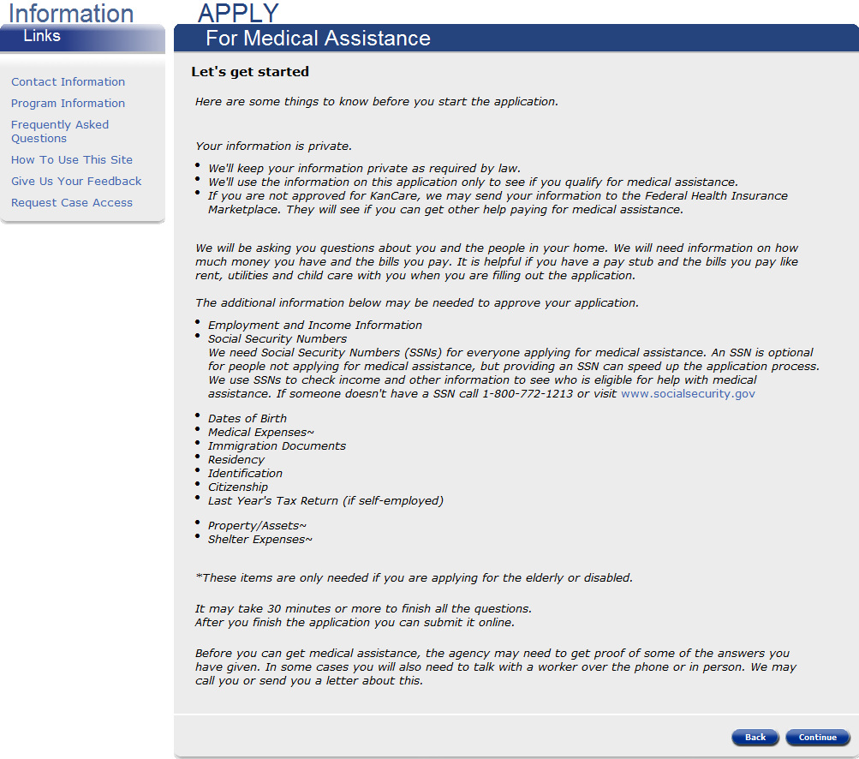
Presumptive Eligibility Tool ILT: Adult
Lesson 4: MCSSP > Sign Up Page
An Overview page displays first. This page explains how the consumer’s information will be used as well as what information will be needed in order to determine their eligibility for KanCare.
The Information Links Menu to the left can be accessed at anytime.

Slide 67
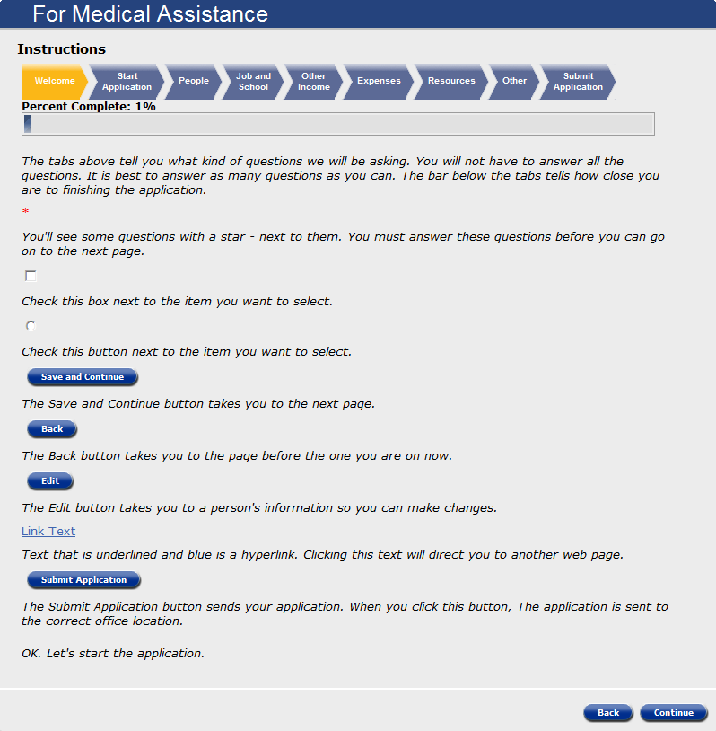
Presumptive Eligibility Tool ILT: Adult
Lesson 4: MCSSP > Instructions
The following page explains how to navigate throughout the MCSSP. The chevrons located at the top of the page indicate the topics of each section of the MCSSP. Beneath this is a progress bar that displays how much of the MCSSP application the consumer has completed.
We’ll walk through one section of the application to get a feel for how it functions.

Slide 68
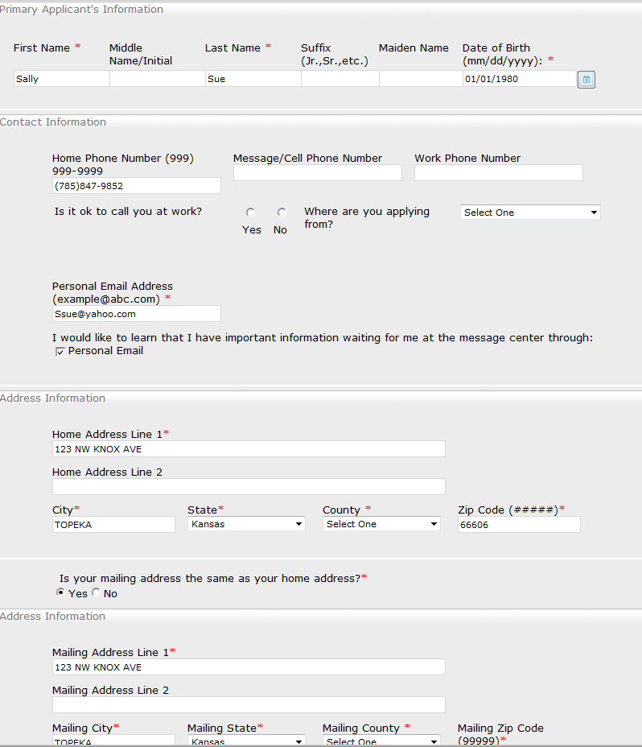
Presumptive Eligibility Tool ILT: Adult
Lesson 4: MCSSP > Primary Applicant Information
Like the PE Tools, the first page of the MCSSP is Primary Applicant Information.
Information the consumer entered when signing up for the MCSSP auto-populates on the Primary Applicant’s Information Page.
Select the County Code from the dropdown menu in the Home and Mailing Address sections.

Slide 69
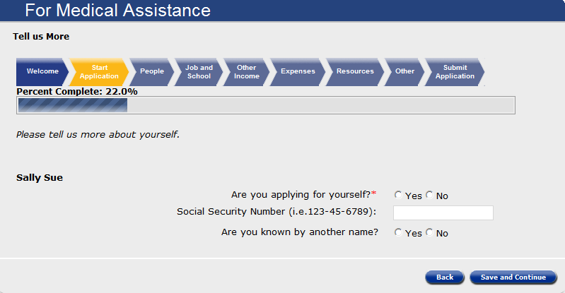
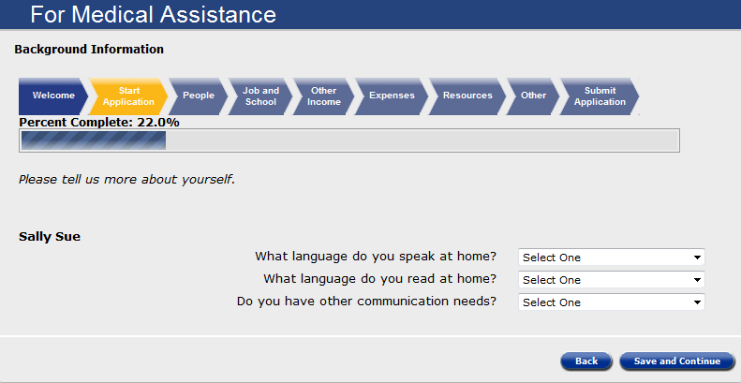
Presumptive Eligibility Tool ILT: Adult
Lesson 4: MCSSP > Tell Us More and Background Information
Tell Us More and Background Information pages will need to be completed for every member of the primary applicant’s household.
Information needed in this section includes:
Applying for Self
SSN
Alias Names
Language Spoken
Language Read
Other Communication Needs

Slide 70
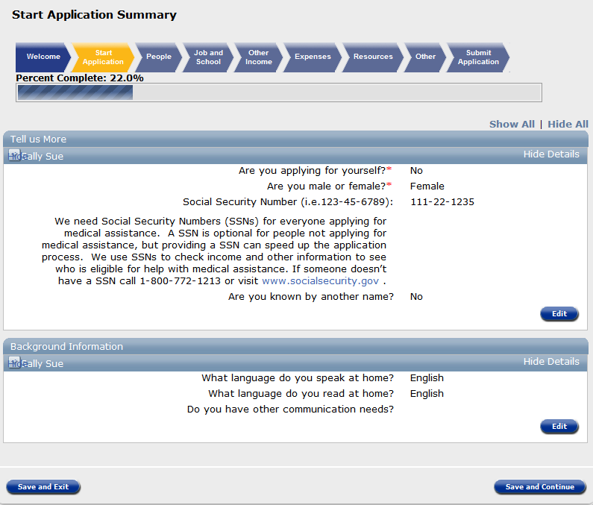
Presumptive Eligibility Tool ILT: Adult
Lesson 4: MCSSP > Start Application Summary
After all the pages of a section have been completed, a Summary page will display. Check all of the data entered to ensure it’s correct. If information is missing or needs to be corrected, click the Edit button in the appropriate section. When all of the information on the Summary screen is correct, click Save and Continue to proceed with the application.

Slide 71
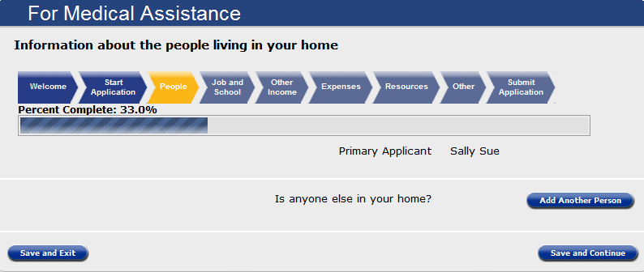
Presumptive Eligibility Tool ILT: Adult
Lesson 4: MCSSP > Progressing Through the Application
Adding information about all of the people living in the primary applicant’s home follows. Once all persons have been added, the application will progress through each section. Answer all questions that apply to the household. At any point in the process, the Save and Exit button can be used, allowing the consumer to complete and submit the application at a later time.

Slide 72
Presumptive Eligibility Tool ILT: Adult
Lesson 4: MCSSP > Summary
Lesson 5 presented information concerning the MCSSP KanCare application including the:
Benefits
Sign Up Process
Navigation
Administrative Features of the PE Tool will be discussed in our last lesson.

Slide 73
Presumptive Eligibility Tool ILT: Adult
Agenda
Lesson 1: Overview
Lesson 2: PE Tool Basics
Lesson 3: PE Adult
Lesson 4: MCSSP
Lesson 5: Administrative Features

Slide 74
Presumptive Eligibility Tool ILT: Adult
Lesson 5: Administrative Features
In addition to completing PE determinations the Tool has several administrative features which are important to know.
Administrative
Security Roles
System Timeout
My PE Applications

Slide 75
Presumptive Eligibility Tool ILT: Adult
Lesson 5: Administrative Features > Security Roles
There are 2 PE security roles for Qualified Entity staff.
QE Staff
Access to the PE Tool
Ability to view PE Tools they have worked on
QE Supervisor
Access to the PE Tool
Ability to view all PE Tools completed by staff at their QE agency

Slide 76
Presumptive Eligibility Tool ILT: Adult
Lesson 5: Administrative Features > Security Roles
An additional security role of QE Superuser is assigned to Policy and Eligibility staff. This role provides Policy and Eligibility staff with access to the PE Tools created by all Qualified Entities.

Slide 77
Presumptive Eligibility Tool ILT: Adult
Lesson 5: Administrative Features > System Timeout
Another important feature to be aware of is System Timeout. The PE Tool will automatically timeout a user when there’s been no activity for 25 minutes. It will provide you with a warning message 5 minutes prior to timeout. Clicking the ‘Continue Working’ button will stop the timeout process. If the button isn’t clicked, the timeout will occur, returning the user to the Log-in page.

Slide 78
Presumptive Eligibility Tool ILT: Adult
Lesson 5: Administrative Features > System Timeout
The system will not automatically save the last page you accessed if new data was entered. However, any work completed on prior pages will be saved. Upon logging back in, the system will always bring you to the Presumptive Eligibility (PE) Overview page rather than where you left off.

Slide 79
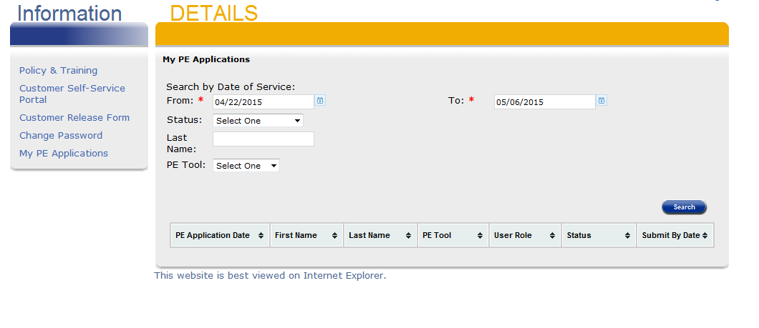
Presumptive Eligibility Tool ILT: Adult
Lesson 5: Administrative Features > My PE Applications
The My PE Applications is a link that can be accessed once a user is logged into the Tool. This feature allows a user to view all of the PE Tools they have worked on.

Slide 80
Presumptive Eligibility Tool ILT: Adult
Lesson 5: Administrative Features > My PE Applications
The From and To fields in Search by Date of Service are populated with default values. QE staff can change these dates to expand or narrow their search by using the text box feature or clicking on the calendar icon.

Slide 81
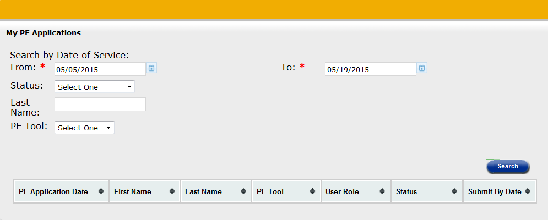
Presumptive Eligibility Tool ILT: Adult
Lesson 5: Administrative Features > My PE Applications
Additional values that can be used to search are:
Status
Incomplete
Denied
Approved
Approved/Denies
Expired
Last Name of Primary Applicant
PE Tool Type
PW
CH
Adult
Click the Search button when all of the criterial has been entered.

Slide 82
Presumptive Eligibility Tool ILT: Adult
Lesson 5: Administrative Features > My PE Applications
When more than one result is returned, arrows or carets located in the column headers can be used to redisplay the data from bottom to top and vice versa.

Slide 83
Presumptive Eligibility Tool ILT: Adult
Wrap up
In this course, we learned about:
Goals of Presumptive Eligibility
Basics of the PE Tool
PE for Pregnant Woman Tool
PE for Children Tool
Medical Consumer Self-Service Portal
Various Administrative Features in the Tool

Slide 84
Presumptive Eligibility Tool ILT: Adult
Questions
If you have further questions regarding the Presumptive Eligibility program, please email them to Training@KEES.KS.gov .

